Slide 1














Brain Stroke Prediction
Presented by kavya sri Gullipalli

Slide 2
Introduction
Stroke, a medical emergency, occurs when blood flow to a part of the brain is interrupted or reduced, leading to the rapid deterioration of brain tissue. Understanding and predicting strokes is pivotal for timely intervention and improved patient outcomes.

Slide 3
The project utilises a comprehensive dataset source from kaggle.com, comprising a CSV file: healthcare-dataset-stroke-data.csv
01.
Utilized a systematic approach, encompassing data collection, preprocessing, and modeling. Employed diverse machine learning algorithms (Random Forest, Logistic Regression, SVC, Decision Tree, K-Nearest Neighbors) to evaluate stroke prediction accuracy.
Abstract
02.
Conducted a comprehensive exploratory data analysis, utilizing histograms, box plots, and visualizations, to understand the distribution of key numerical features (age, BMI, average glucose level) and the prevalence of stroke across categorical variables (gender, work type, smoking status).
03.

Slide 4

Objective-
The World Health Organization (WHO) identifies stroke as the second leading cause of global mortality, contributing to approximately 11% of total deaths. Our project aims to develop a predictive model for stroke occurrence based on various input parameters, such as gender, age, presence of hypertension, heart disease, marital status, occupation, residence type, average glucose level, body mass index (BMI), and smoking status. The dataset utilized contains information on 5110 individuals, with the goal of predicting stroke occurrence.

Slide 5

Significance of the Project-
Mortality Impact:
Early stroke identification for potential mortality reduction.
Preventive Healthcare:
Predicts strokes for timely preventive interventions.
Data-Driven Insights:
Informs healthcare with insights on health attributes and strokes.
ML Applications:
Demonstrates machine learning's role in advanced healthcare modeling.
Public Health Impact:
Aligns with global health goals, aiding non-communicable disease prevention.

Slide 6
Python Libraries Used
01
02
03
04
05
Pandas: Streamlines data manipulation and analysis, ensuring a comprehensive exploration of the dataset.
NumPy: Powers numerical operations on large datasets, providing a robust foundation for our analyses.
Seaborn and Matplotlib: Craft informative and visually appealing plots, facilitating a clear understanding of data patterns.
Warnings and Datetime: The warnings module is imported to manage warning messages, while the datetime module facilitates date and time operations in the Python script.
Scikit-learn: Simplifies machine learning with preprocessing, model selection, and evaluation, offering a holistic approach to model development.

Slide 7


Python:
Python serves as the primary programming language for this project, providing a versatile environment for data analysis, machine learning, and visualization.
Pandas:
Pandas is used for data manipulation and analysis. It provides data structures like DataFrames, facilitating the handling of tabular data.
Data Preprocessing:
The project includes data preprocessing techniques such as handling missing values, dropping unnecessary columns ('id'), encoding categorical variables, and scaling numeric features.
Exploratory Data Analysis (EDA):
EDA is performed using Seaborn and Matplotlib for visualizing numeric and categorical features, including kernel density plots, boxplots, scatterplots, and count plots.
NumPy:
NumPy is employed for numerical operations and array manipulations, enhancing the efficiency of mathematical computations.
Seaborn and Matplotlib:
Seaborn and Matplotlib are visualization libraries used for creating plots and charts, aiding in the exploration of data distributions and patterns.
Tools and Techniques
Various machine learning algorithms are implemented, including:
Random Forest Classifier
Logistic Regression
Support Vector Classifier (SVC)
Decision Tree Classifier
K-Nearest Neighbors (KNN)
Scikit-learn:
Scikit-learn is a machine learning library that offers a wide range of tools for data preprocessing, model training, and evaluation. It includes various algorithms and utilities for classification and regression tasks.
GridSearchCV:
GridSearchCV, part of Scikit-learn, is utilized for hyperparameter tuning. It systematically searches through a predefined hyperparameter space to find the optimal configuration for a machine learning model.
Min-Max Scaling:
Min-Max scaling is applied to numeric features using Scikit-learn's MinMaxScaler, standardizing their values within a specified range.
Hyperparameter Tuning:
GridSearchCV is employed for hyperparameter tuning, systematically searching for the best hyperparameter configuration for each machine learning model.

Slide 8

Dataset Overview-
Our dataset is a comprehensive compilation of key factors that play a role in stroke occurrence. Each entry is characterised by a unique identifier (id) and encompasses vital information such as gender, age, hypertension, heart disease status, marital history, work type, residence type, average glucose level, body mass index (BMI), smoking status, and the occurrence of a stroke.

Slide 9
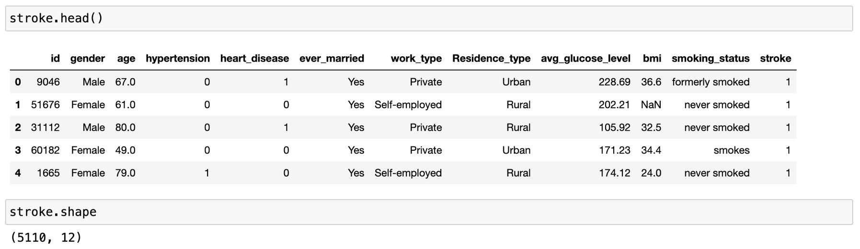
Dataset:

Slide 10
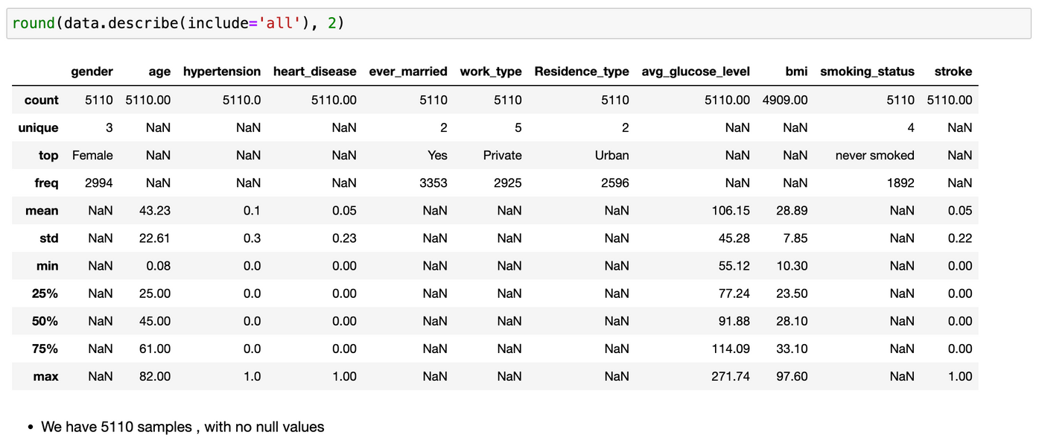
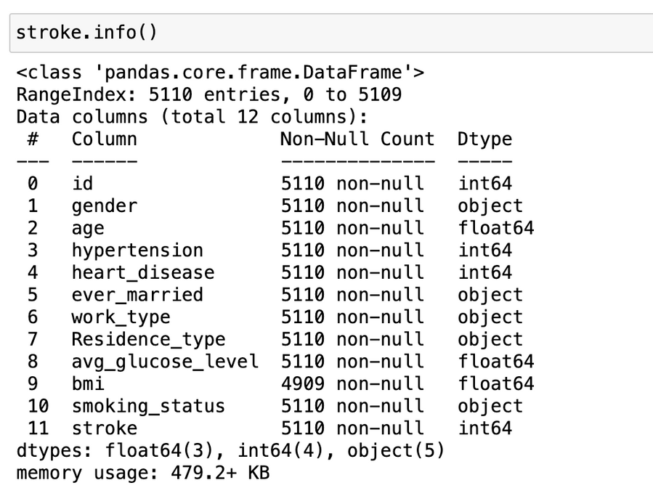
describe()
info()

Slide 11

Visualisations

Slide 12
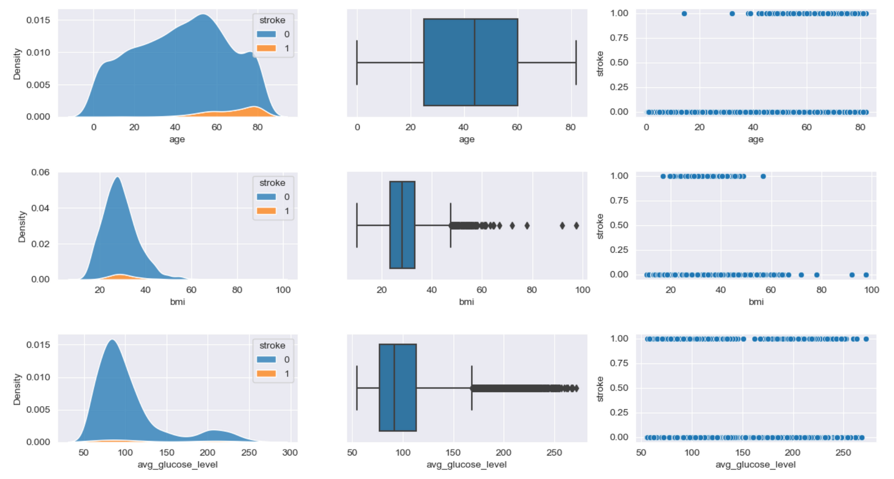
Visualisations:

Slide 13
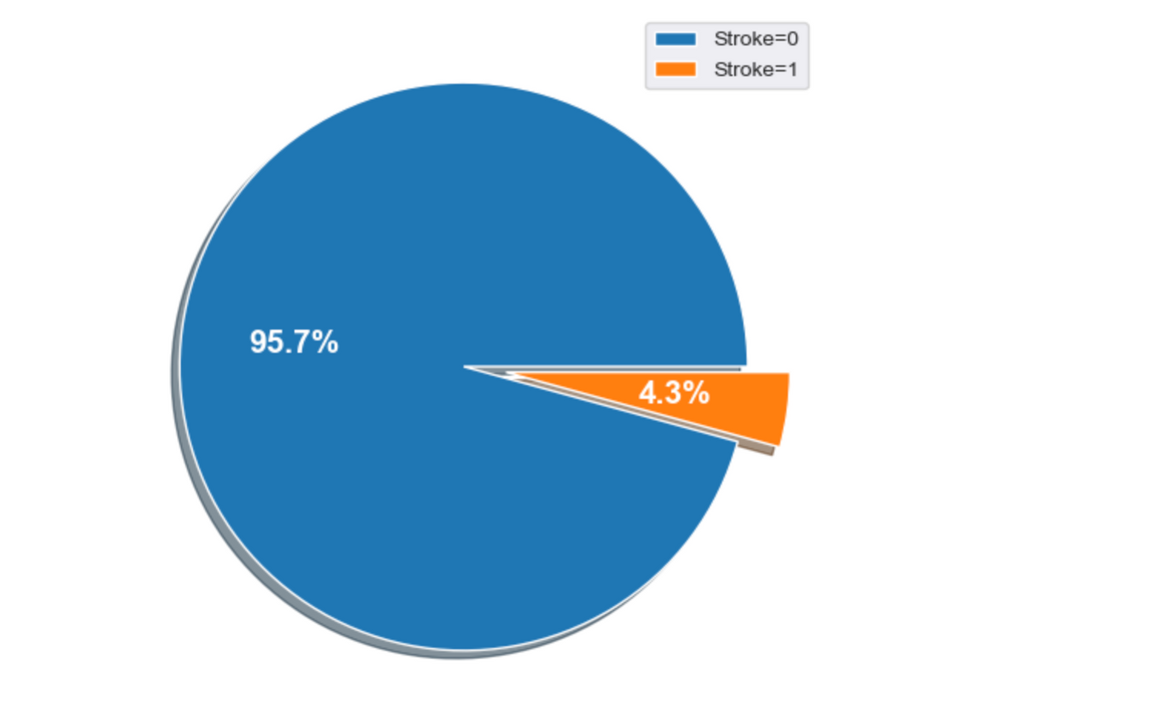
Pie-chart for target variables:

Slide 14
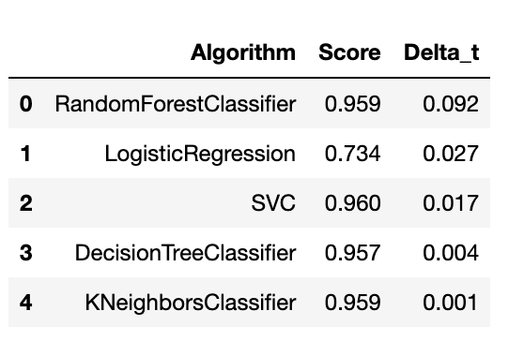
Result:

Slide 15
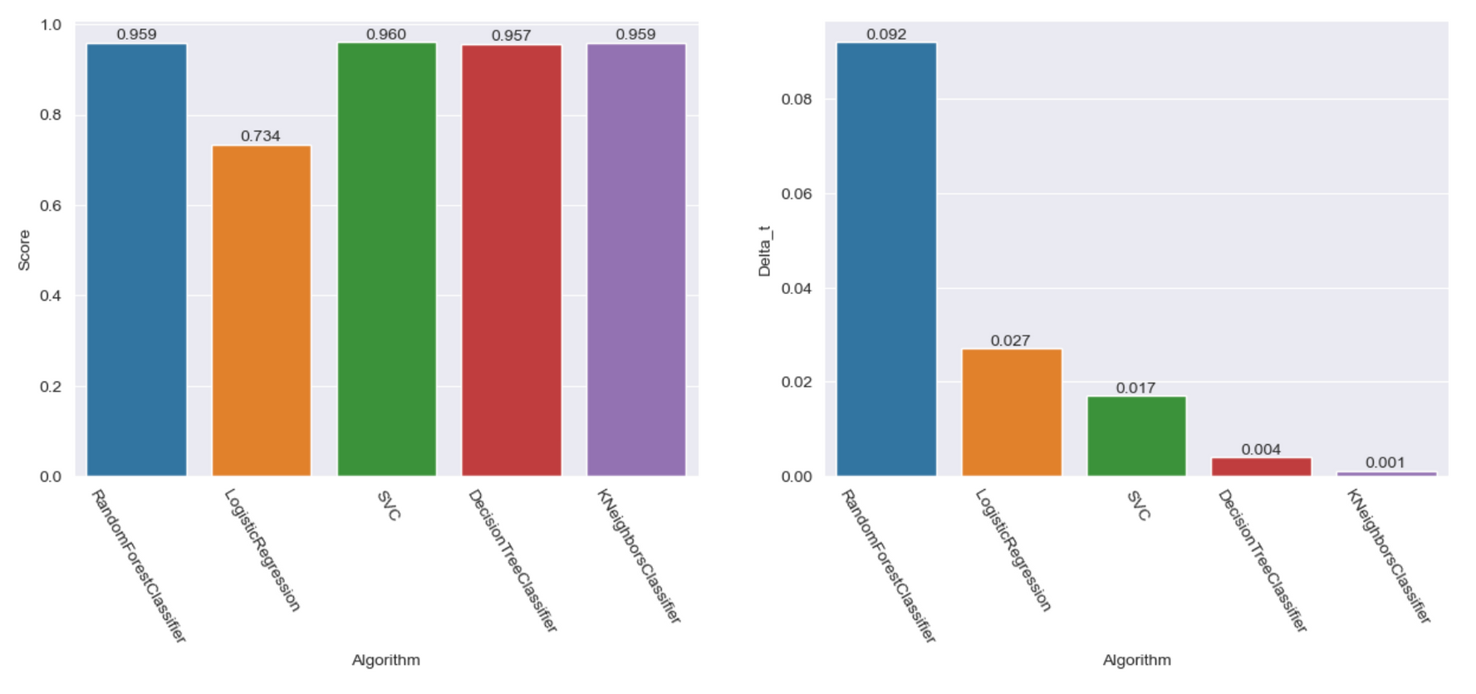
Bar charts of model scores and time taken:

Slide 16
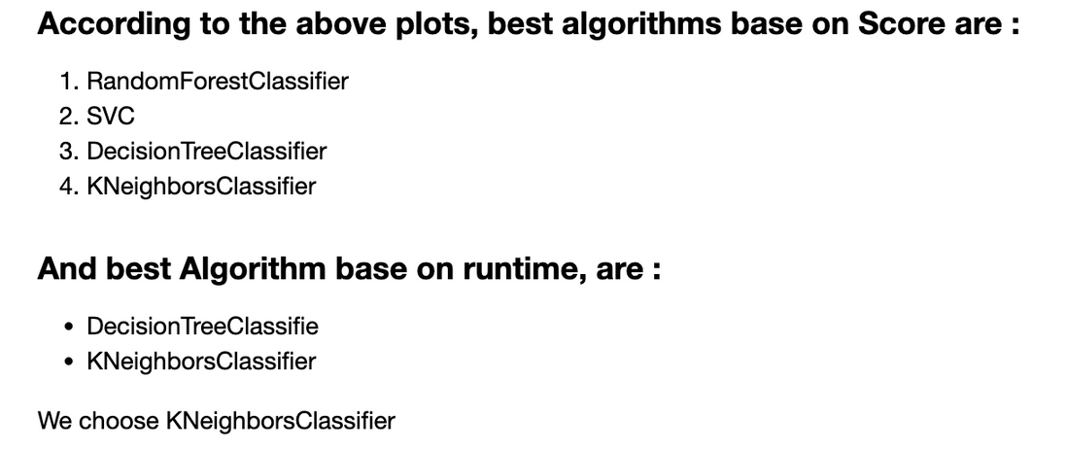
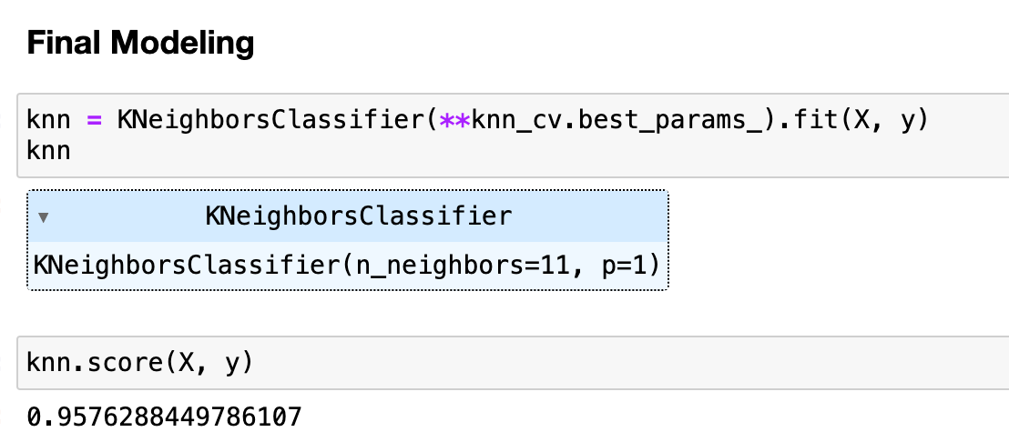
Results:

Slide 17
Conclusion
In summary, this project on stroke prediction follows a systematic methodology, encompassing comprehensive data preprocessing, exploratory data analysis (EDA), and the application of diverse machine learning algorithms. Rigorous cleaning procedures, including the removal of missing BMI data, were implemented to ensure the dataset's integrity. EDA provided valuable insights into both numeric and categorical features, guiding subsequent modeling decisions. The utilization of Random Forest Classifier, Logistic Regression, Support Vector Classifier (SVC), Decision Tree Classifier, and K-Nearest Neighbors (KNN) facilitated a holistic assessment of predictive capabilities, with hyperparameter tuning optimizing model performance. Noteworthy findings include the robust performance of the Random Forest Classifier, the simplicity of Logistic Regression, the effectiveness of SVC in handling non-linear relationships, the interpretability of Decision Tree modelling, and the influential role of KNN in predicting stroke occurrences. While model accuracy is commendable, considerations for specific application requirements are essential. Future directions may involve further model refinement, integration into clinical decision support systems, and ongoing exploration of advanced techniques to enhance predictive healthcare decision-making. Overall, this project makes a significant contribution to leveraging data-driven insights for stroke risk assessment and intervention.

